Slide 1
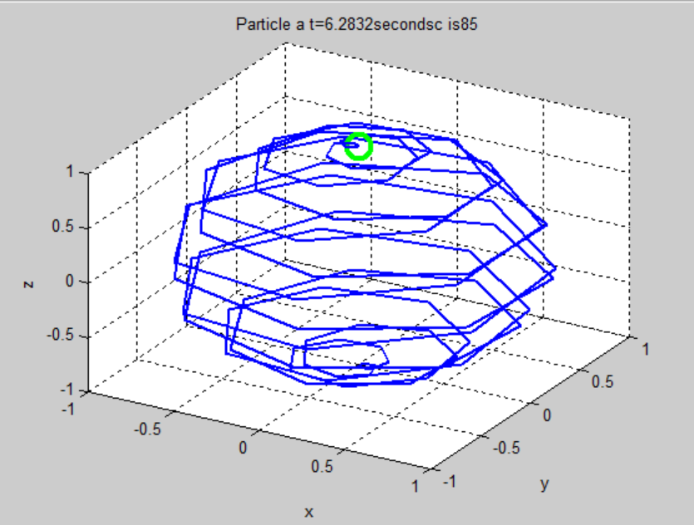
Animations Using Position Vectors in MATLAB
Kritika Verma
Siddhartha Mahajan
Fig 1.1: Spiral Sphere 3D Line Plot

Slide 2
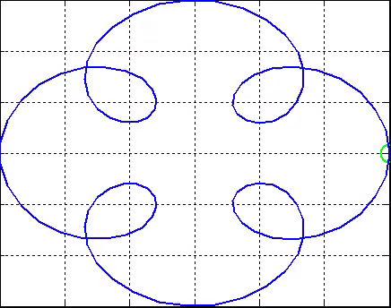
Introduction
Although, we know how plotting works in MATLAB. It's hard to see the trajectory of a particle by looking at the already formed graph. The same can be said about discrete dynamical systems that change with time. A better method of plotting these can be with the help of animation which will give a more vivid idea of how the system of equations works.
Fig 1.2:Flower Animation Plot

Slide 3
Methodology
To animate in MATLAB we use a frame-by-frame method. All animations and videos are just a lot of images stitched together. Just like in a flip book, if changes are made little by little, and then the pictures are flipped by really fast, it looks like an animation. We tried to do the same thing in MATLAB.
This Photo by Unknown Author is licensed under CC BY

Slide 4
Steps to Make an Animation in MATLAB
Run a simulation and generate all the data points.
Draw/render/plot the scenario at time t_{k}.
Take a snapshot of the scenario and store it.
Advance time to t_{k+1}
Repeat the process from Step 2.
Make a movie from the acquired snapshots.

Slide 5
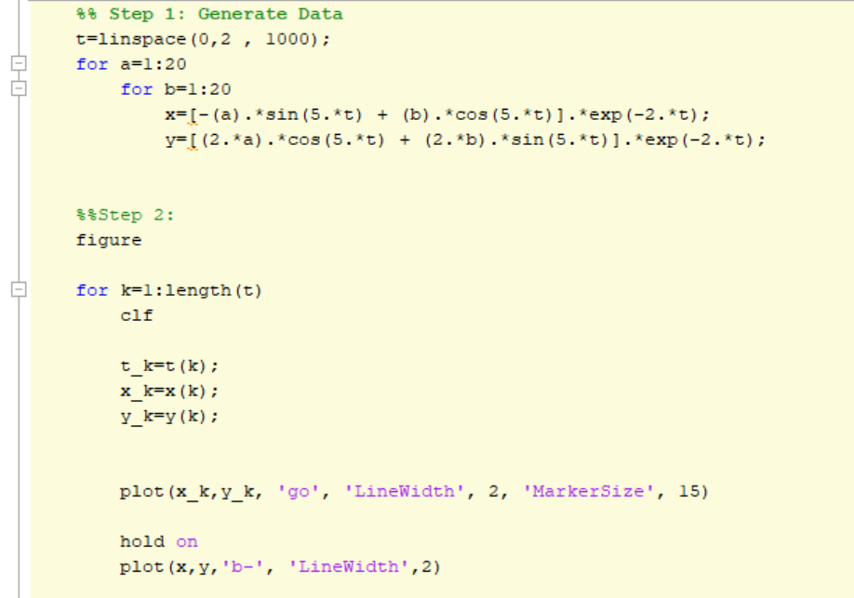
An Outline of the Code
Step 1: Generating Data Points
First, we took a dynamic system and after generating its vector space solution with respect to time
Step 2 : Rendering the scenario at time t_{k}
And now we’ll run the loop for the amount of time we’ve chosen.

Slide 6
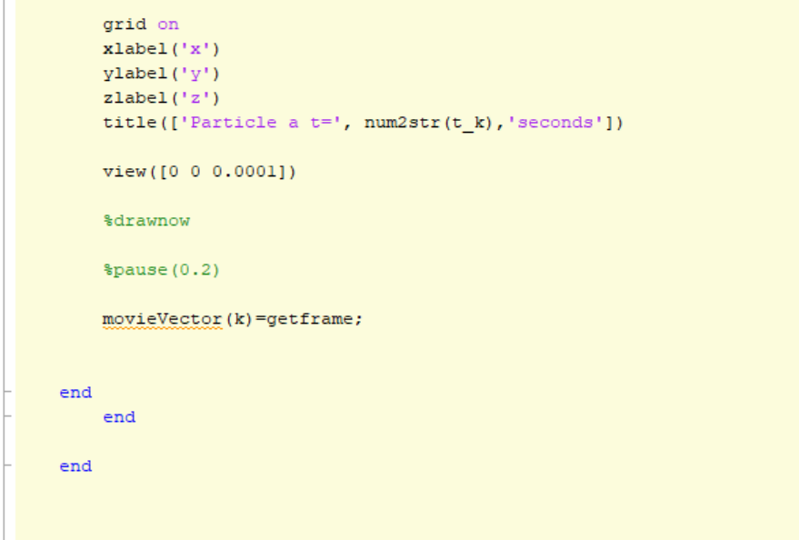
An Outline of the Code
Step 3: Take a snapshot of the scenario and store it.
With this statement, it saves each snapshot at every iteration.
Step 4: Advance time to t_{k+1.}
Step 5:Repeat the process from Step 2.

Slide 7
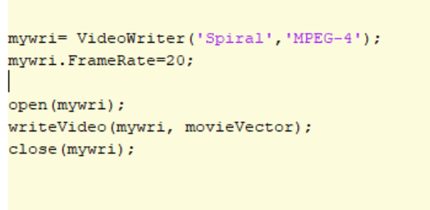
An Outline of the Code
Step 6: Making a movie from the acquired snapshots.
This statement changes all the previously saved snapshots and converts them into a movie.

Slide 8
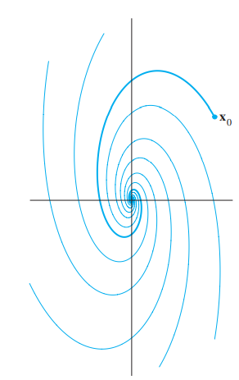
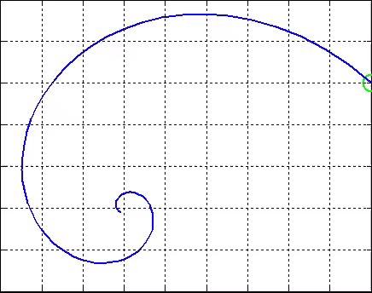
Result
The set of equations we chose was from a dynamic system that consists of complex Eigenvalues. So, theoretically, we should get a spiral. And since we took a negative exponential our system should tend towards 0. Our resultant plot should look something like a spiral depicting x₀ in the following image.
Fig 1.3(a): The expected plot
Fig 1.3(b): Our Plot

Slide 9
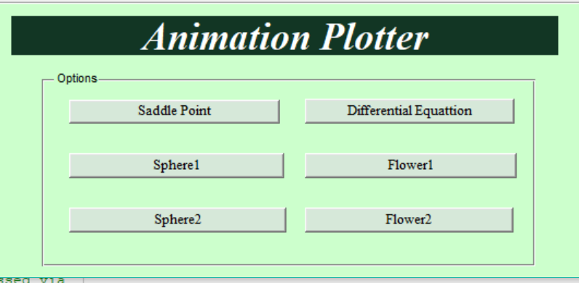
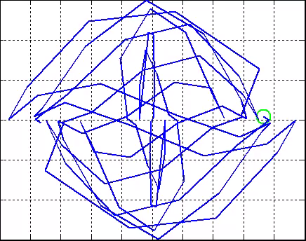
Our GUI
These are a few of the plots we made.

Slide 10
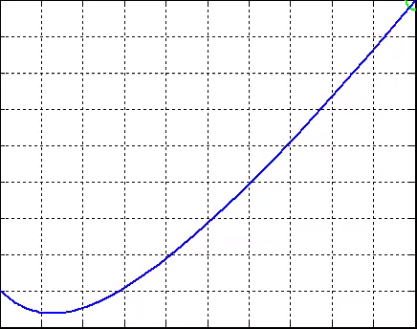
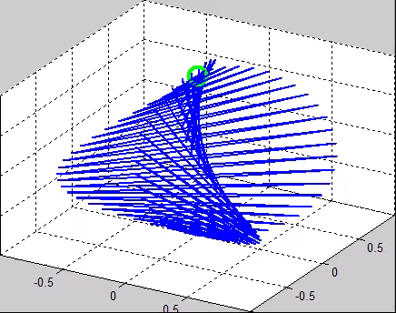
Some of the Rendered Animations:
Fig 1.5: A Few of the Animated Plots

Slide 11
Thank You
Kritika Verma
Siddhartha Mahajan
II Semester (B. Tech (IT and MI))

